Slide 1
Cosine Ratio
Miss L
Year 12 Essentials

Slide 2
Learning Intentions
Students will be able to
Find the unknown sides and angles using the Cosine Ratio

Slide 3
Practical Activity
Students will need:
One student (work in groups of 4)
A tape measure
A giant protractor
Your brain

Slide 4

Practical Activity
Students will need to
Find the hypotenuse
Find angle B
You can only measure the student and line on the floor!
Answers will vary
hypotenuse
B°

Slide 5
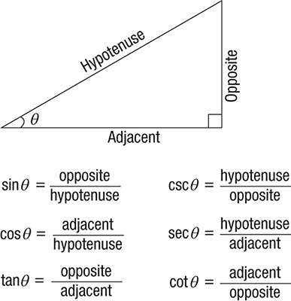
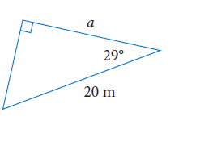
Trigonometry Functions
If we are given the hypotenuse and the adjacent side we use the Cosine Ratio

Slide 6
Trigonometry Functions
We can use
SOH CAH TOA to remember the functions

Slide 7

24
7
30
Trigonometry
Date
EQ – How do we use the Cosine Ratio to find sides and angles?

Slide 8
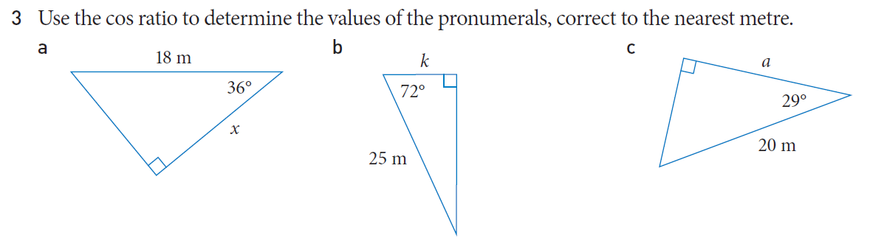
Practice
Get the person next to you to mark your work, be prepared to share your answers

Slide 9


Slide 10
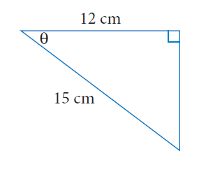
24
7
30
Trigonometry
Date
EQ – How do we use the Sine Ratio to find sides and angles?
Cosϴ = Adjacent
Hypotenuse
Cosϴ = 12
15
Cosϴ = 0.8
ϴ = Cos ⁻¹ (0.8)
ϴ = 36.87° (degrees)

Slide 11
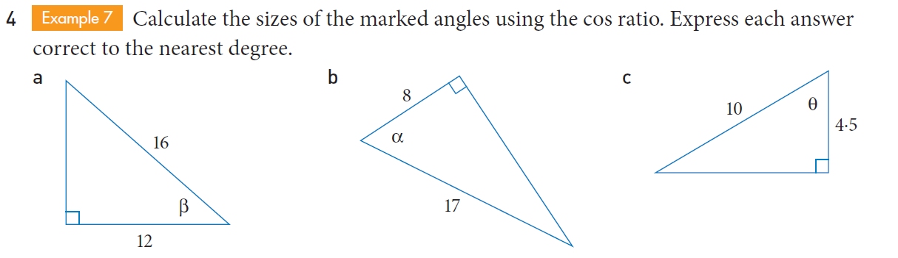
Practice
Get the person next to you to mark your work, be prepared to share your answers

Slide 12
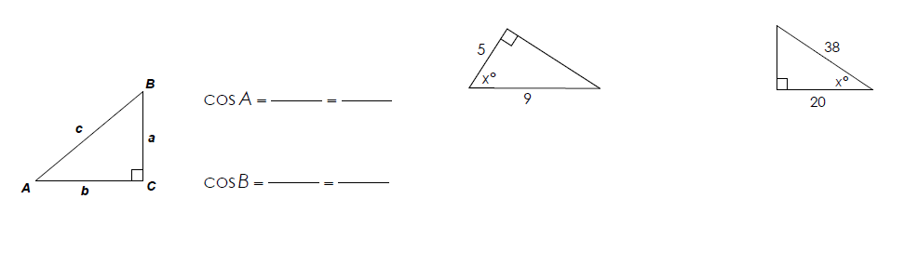
Task
Complete the worksheet
We will go through the answers together after, be prepared to share your answers
Complete Exit Pass – the Cosine section of your foldable

Slide 13
